Slide 1
Boost
Presented by 8-bit Bacon

Slide 2
Team Members

Slide 3
The Vision
-Art of game vision-

Slide 4
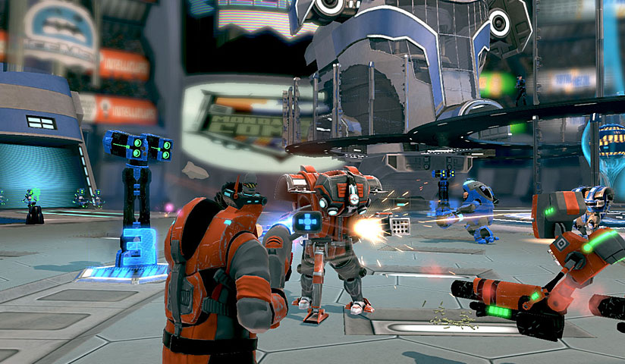
Inspiration

Slide 5
Player Actions
Shoot
70%
Boost
30%

Slide 6
Shoot
RT
Shoot
Player shoots with their equipped weapon.
-Art of player killing enemies, and manipulating environment

Slide 7
Boost
LT
Boost
Player moves at a faster pace or dodges to the side.
-Art of player dodging enemy fire, sprinting forward, and knocking enemies down with melee-

Slide 8
Game Flow
Progress
Combat
Progress
Combat
Exit

Slide 9
Enemies
Grunt
If P is within effective range
Shoot Player (1s)
If P is within range
Melee Attack Player
1 M
Weapon Range
-Art of 2 enemy types, assault rifle and shotgun-

Slide 10
Protagonist
The protagonist is a muscular man wearing body armor and sporting a variety of weapons.
-Art of Protagonist here-
Attributes
50/50
If Health = 0, decrement money
Phone a friend
Health
Lifeline
Increase Speed, dodge, increase damage
Boost
LS
Decrement Boost
Hold

Slide 11
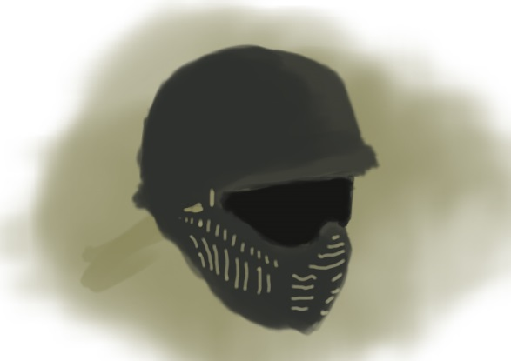
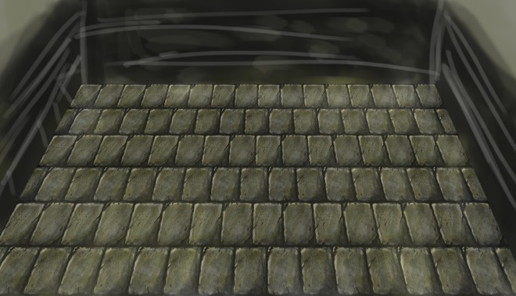
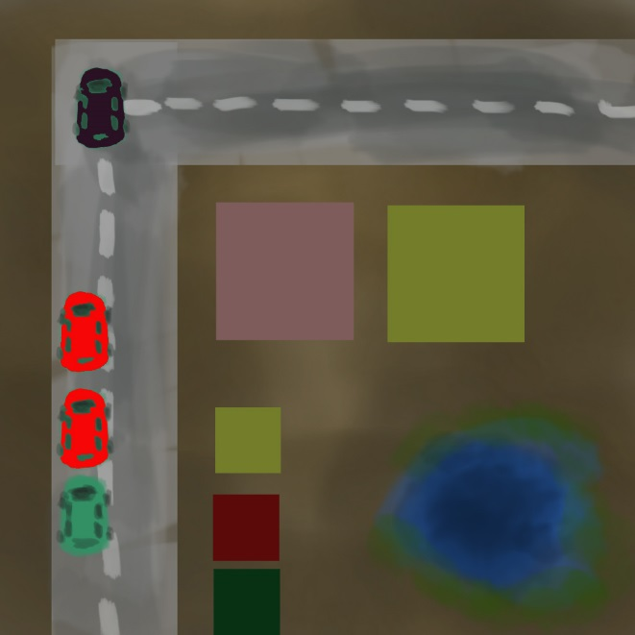
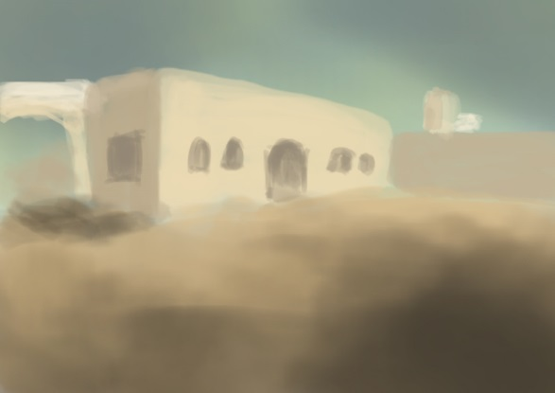
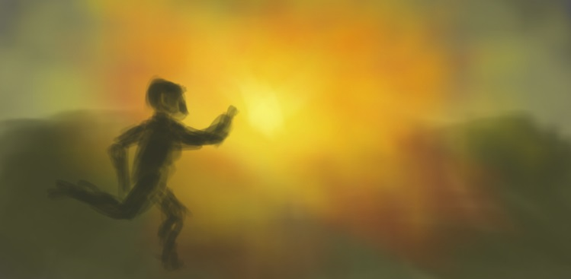
Where
Modern day urban environment

Slide 12
Where – Urban Arena
An arena filled with buildings and debris

Slide 13
Where – Forest Arena
An arena cluttered with trees and bushes

Slide 14
Where – Coliseum Arena
A flat, hexagonal arena with some obstacles in the middle.

Slide 15
Level Layout

Slide 16
Why
To earn the prize money for winning at the game show.

Slide 17
HUD
Health, Boost, and Weapon + Ammo

Slide 18
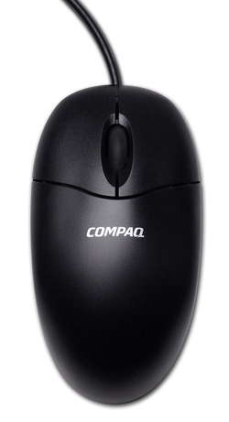
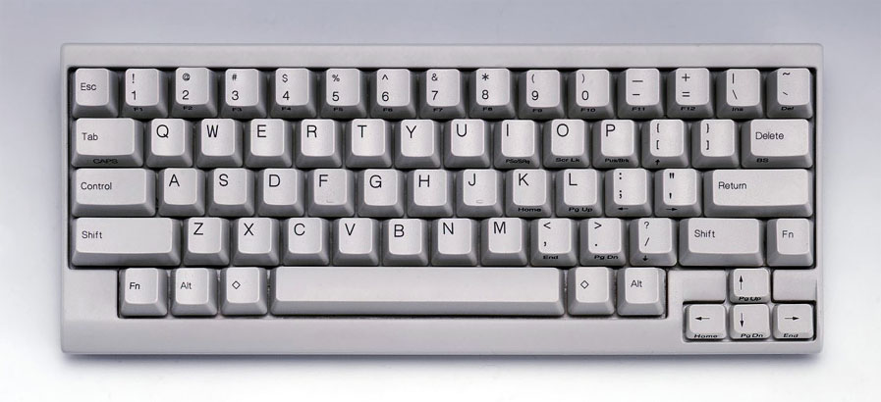
Controls - Keyboard
Move
Melee
Shoot
Boost
Pause

Slide 19
Controls - Controller

Slide 20
Recap
Intense, fast-paced 1st Person Shooter
Occurs within a virtual world
You are an average Joe who wants to win the game show and get the prize money.

